Slide 1
Air Pollution and the Burden of Childhood Asthma in the Contiguous United States using State-Specific Asthma incidence rates in 2010
Raed Alotaibi and Haneen Khreis

Slide 2
Practicum - Aim
Estimate the Burden of Disease of Asthma due to Traffic Related Air Pollution (TRAP) among Children in the US using State-Specific Incidence Rates and comparing the results with previous analysis using a single National Incidence Rate

Slide 3
Practicum Objectives
Objective 1: Prepare air pollution, census and asthma survey data sets for epidemiological analysis.
Objective 2: Estimate the burden of disease of childhood asthma due to air pollution in the US at a national and state level and compare health burden across the different social strata.
Objective 3: Design and develop health promotion material illustrating the impact of the burden of air pollution on children.
Objective 4: Demonstrate the underlying methods and explain the burden of disease project to the organizational workforce.
Objective 5: Participate in the write up of a scholarly article with the organization

Slide 4
Practicum deliverables
Objective 1:Prepare multiple burden data sets at varying geographical levels, tables for asthma incidence rates by state and a tutorial for step by step.
Objective 2:Produce tables and plots for the results of the study.
Objective 3:Publish interactive tables and maps.
Objective 4:Presentation and GITHUB repository
Objective 5:Write-up methods and results section of a paper.

Slide 5
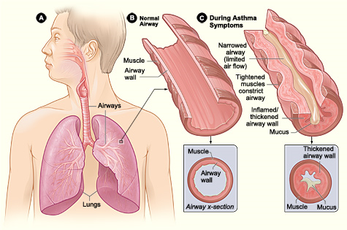
Introduction - Asthma
Asthma is the reversible or partially reversible obstruction of airflow presenting as episodes of wheezing, cough and shortness of breath with varying degrees of severity
By United States-National Institute of Health: National Heart, Lung, Blood Institute - http://www.nhlbi.nih.gov/health/health-topics/topics/asthma/, Public Domain, https://commons.wikimedia.org/w/index.php?curid=24760677

Slide 6
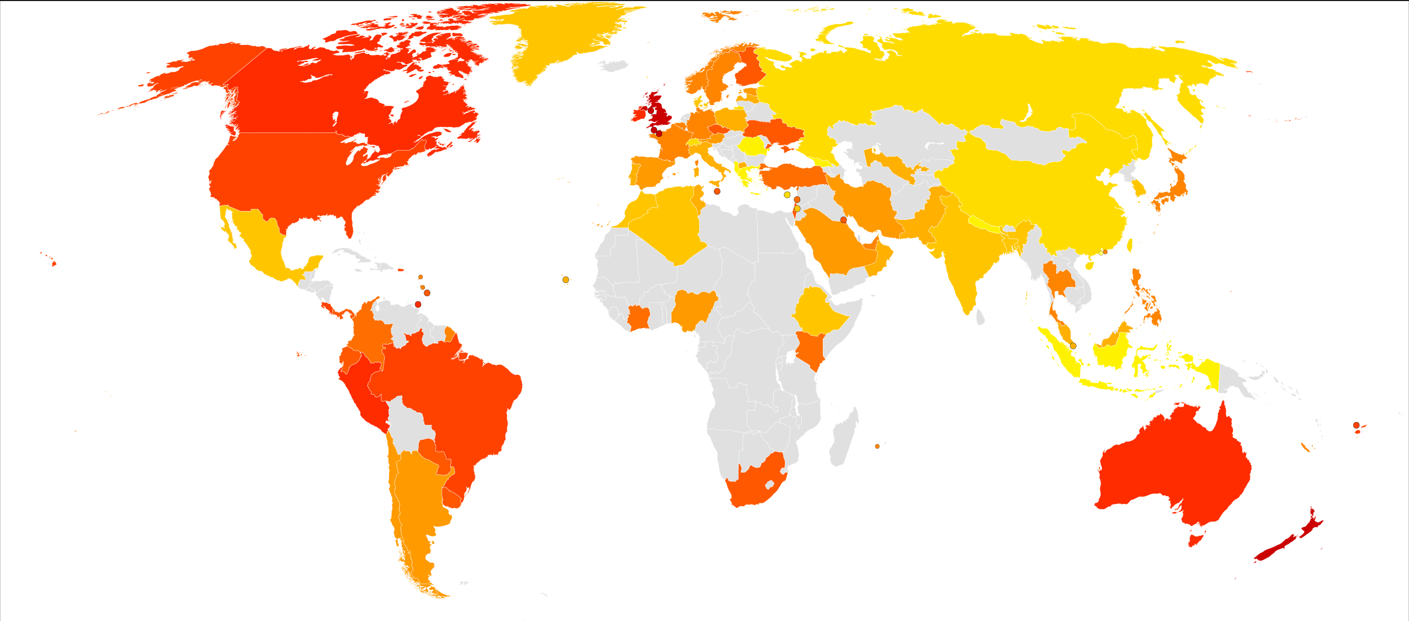
Introduction – Burden of Asthma
Globally
334+ million people with asthma
United States
20 million adults and 6 million children
2006-2010, around 60% if children with asthma → Persistent asthma
Image By Lokal_Profil - Vector map from BlankMap-World6, compact.svg by Canuckguy et al.Data from GINA - Global Burden of Asthma (2004-05)Created using the LP map generator., CC BY-SA 2.5, https://commons.wikimedia.org/w/index.php?curid=23760319
Notes:
Persistent asthma: Either being on long-term control medications or having uncontrolled asthma.
----
(Global Asthma Network, 2014)
(The Lancet, 2018)
(CDC, 2010)

Slide 7
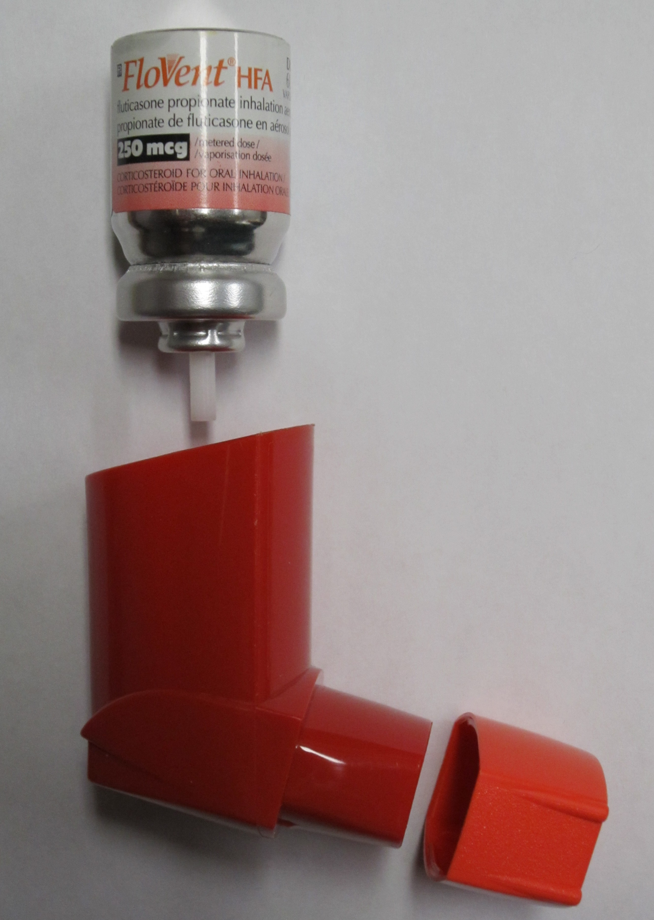
Introduction - Burden of Asthma
$56+ billion each year in health care costs in the US
Families with asthmatic children spend on average $1,737 more on health care
By James Heilman, MD - Own work, CC BY-SA 3.0, https://commons.wikimedia.org/w/index.php?curid=10313945
Notes:
Compared to families with children that are asthma free
-----
(CDC, 2010)
(Nurmagambetov et al. 2018)

Slide 8
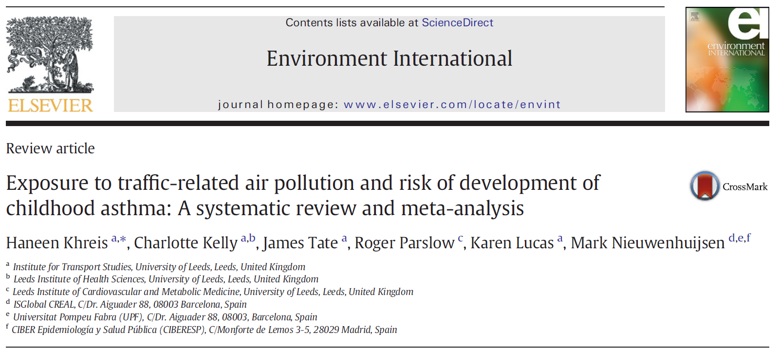
Introduction – TRAP and Asthma
Notes:
Asthma caused by Interaction of genetic and environmental factors
More recently TRAP has been identified to cause asthma among children
Systemic Review by Khreis et al 2017

Slide 9
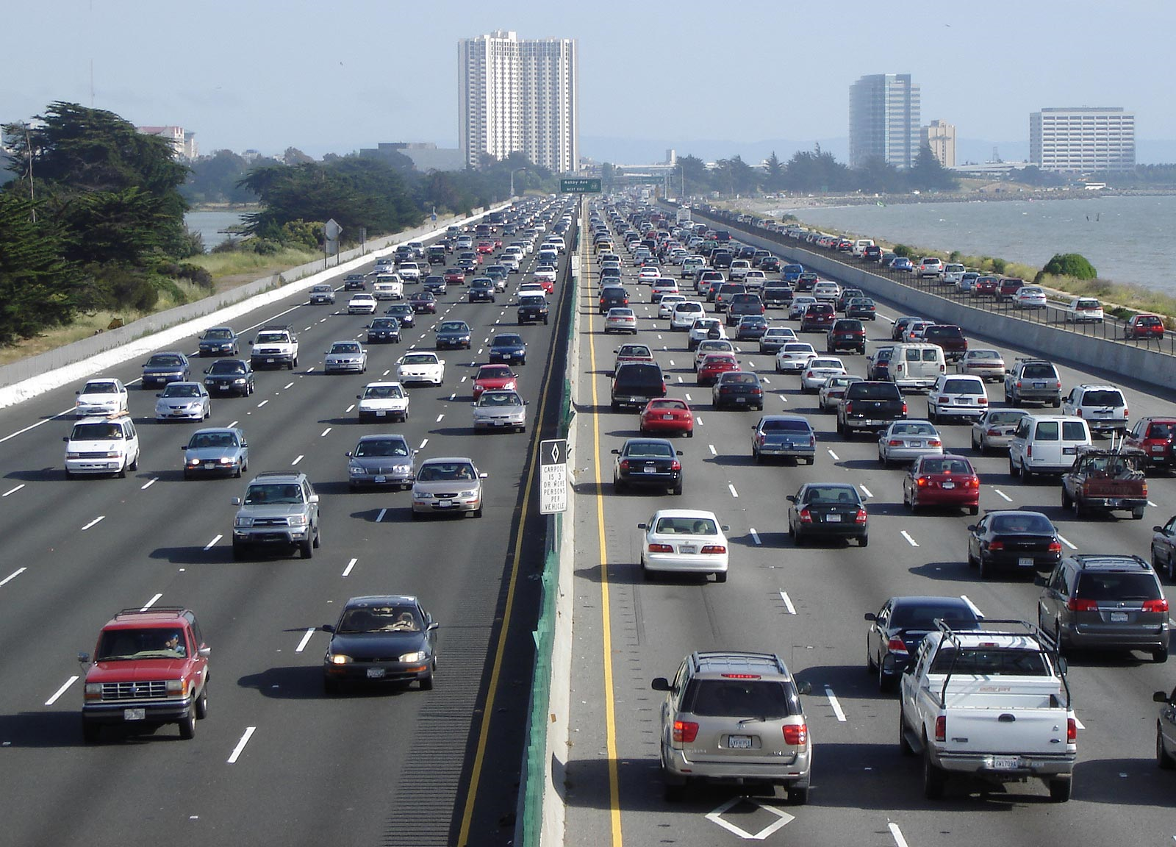
Introduction - TRAP
What is TRAP?
How is exposure to TRAP measured?
Estimated using surrogates
Buffer zone (distance to road and traffic volume)
Chemical surrogates (NO_{x}, PM, BC ..etc)
NO₂ is a good predictor of traffic
By User Minesweeper on en.wikipedia - Minesweeper, CC BY-SA 3.0, https://commons.wikimedia.org/w/index.php?curid=1302402
Notes:
(Ambient air pollution), although well known to exacerbate pre-existing asthma, did not lead to the onset asthma
Emerging evidence shows that more specific types of air pollution are associated with asthma onset, specifically traffic-related air pollution (TRAP), challenging prior belief
TRAP measured as Nitrogen Dioxide (NO₂), Black Carbon, Particulate Matter less than 2.5 um (PM_{2.5}) and Particulate Matter less than 10 um (PM₁₀)
------
(Krzyzanowski and Cohen, 2008)
(WHO, 2005)
(Anderson et al., 2011)
(Anderson et al., 2013)
(Khreis et al., 2017)

Slide 10
Methods - Overview
Estimated the Burden of Disease using the following data
Concentration Response Functions (Literature)
Air Pollution - NO₂ concentration (LUR* Models)
Asthma Incidence Rate (ACBS* and BRFSS*)
Census Data
Using standard burden of disease assessment methods to estimate
Attributable number of asthma incident cases due to NO₂ exposure
Percentage of all asthma incident cases
Among Children (<18 years)
*LUR = Land Use Regression
*Asthma Call Back Survey and Behavioral Risk Factor Surveillance System
Notes:
In other words, what is the percentage of new asthma cases due to TRAP

Slide 11
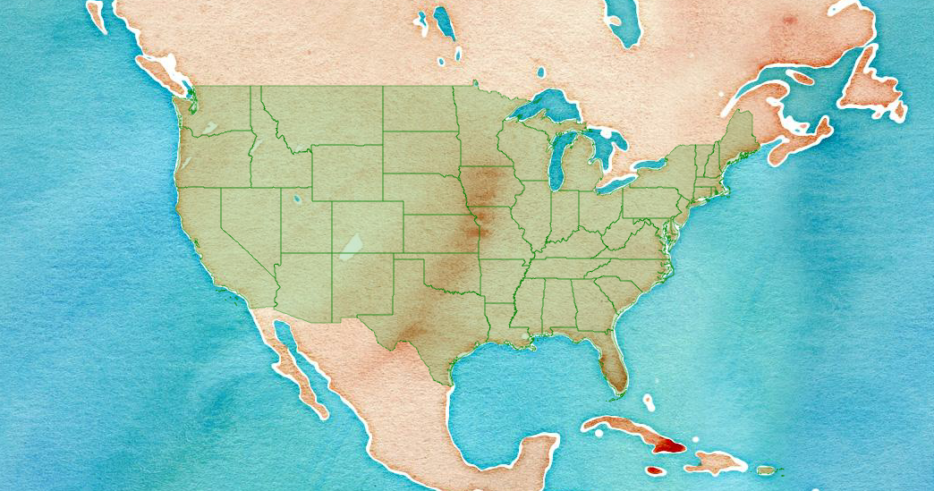
Methods – Location, Time point, and Geographical levels
Study Area and Time
48 states and D.C.
2010
Census Block level
Notes:
Contiguous US

Slide 12
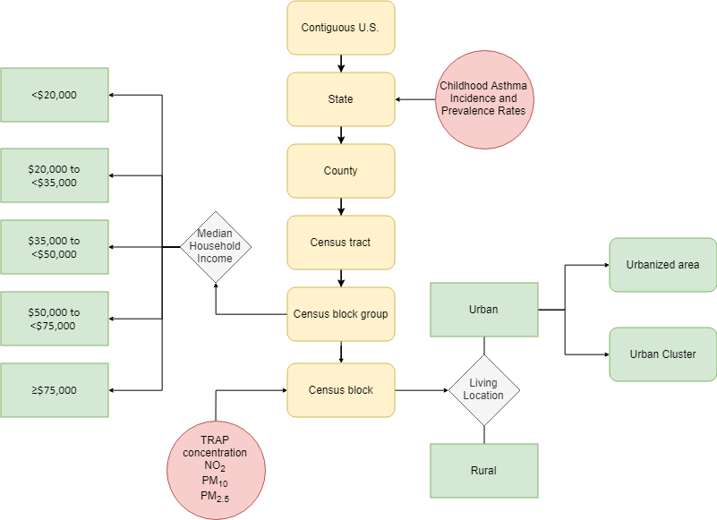
Notes:
Census blocks are the smallest available geographical unit for census data (Building block of all other units)
------
(US Census Bureau, 2010)

Slide 13
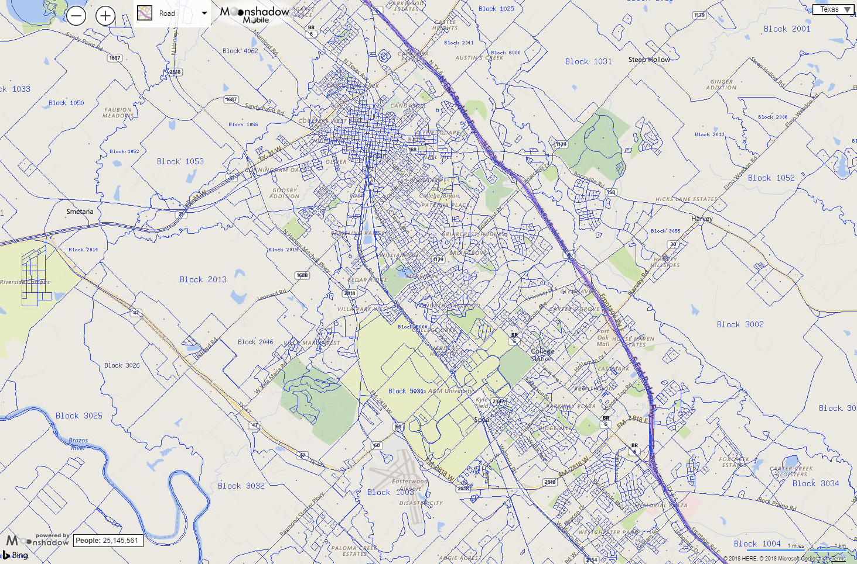
texas.us.censusviewer.com
Notes:
Map of census blocks in the Bryan-College Station area.
Each square represents a census block
Census blocks are usually delineated by a street, road, stream or any visible physical boundary
Blocks vary in size mainly depending on the population counts within them (Urban area vs rural area)

Slide 14

Methods – Census Data
Census data
National Historical Geographic Information System (NHGIS)
Population count (Census block)
Urban/Rural designation (Census block)
Median household income (block group)
Living Location
Urbanized Areas
Urban Clusters
Rural
Median Household Income
<$20,000
$20,000 to <$35,000
$35,000 to <$50,000
$50,000 to <$75,000
>=$75,000
Notes:
Source of the census data was the NHGIS website
For each census block we obtained Urban/Rural information and Median household income
---------
(Manson et al., 2017)

Slide 15
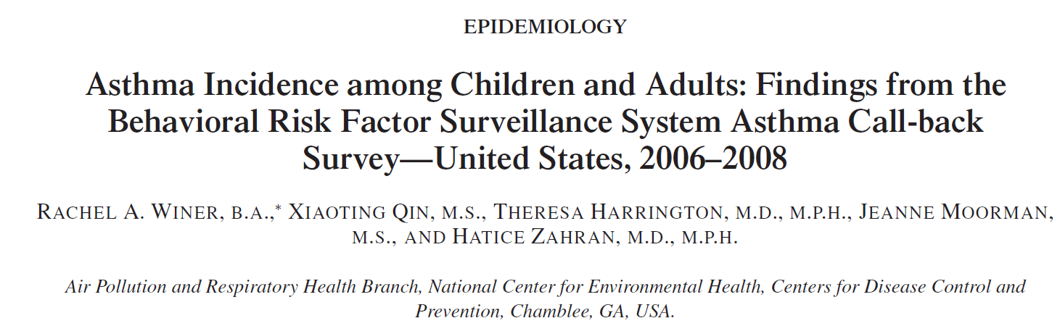
Methods – Asthma Incidence Rate
Asthma Call Back Survey
Period 2006-2010
Not all states had available data
Notes:
Asthma incidence rate was estimated as the number of newly diagnosed asthma cases, within a specified time period, among at-risk children.
The incidence study used data from the Behavioral Risk Factor Survey (BRFSS) and the Asthma Call Back Survey to estimate the incidence rate
Not all states were included in the surveys
-----------
(Winer et al. 2012)
(Blackwell et al., 2003)
(Bloom et al., 2011)

Slide 16
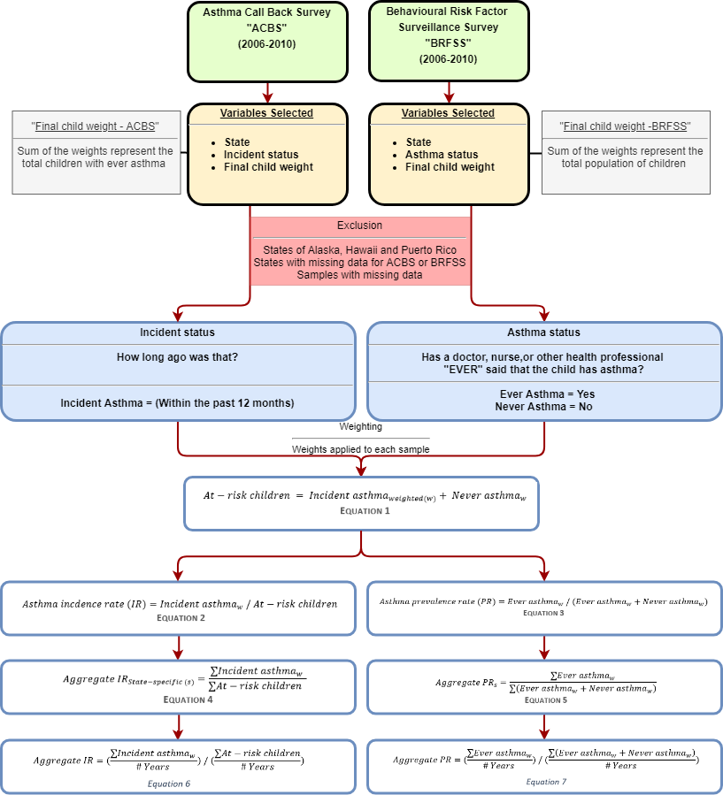
Methods – Asthma Incidence Rate

Slide 18
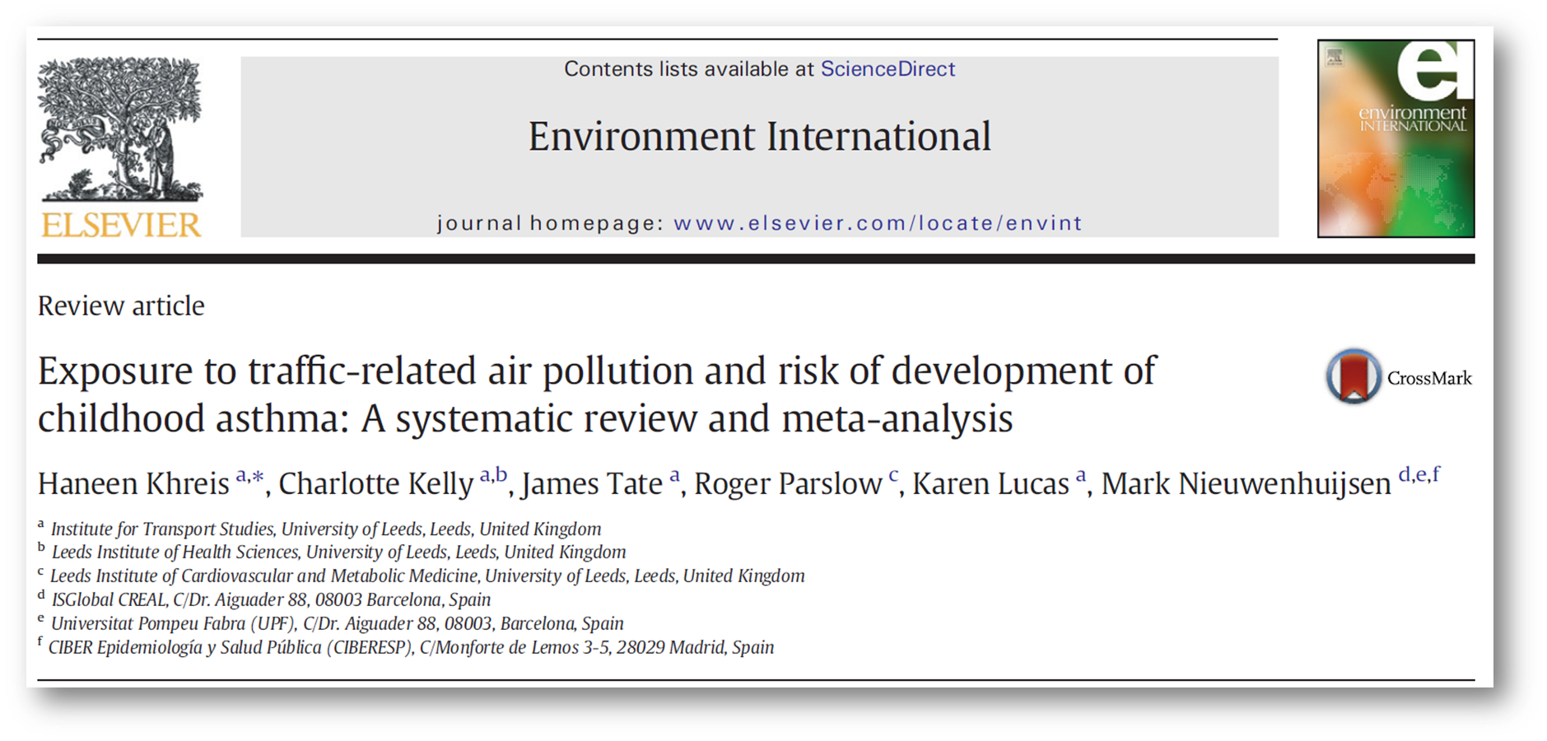
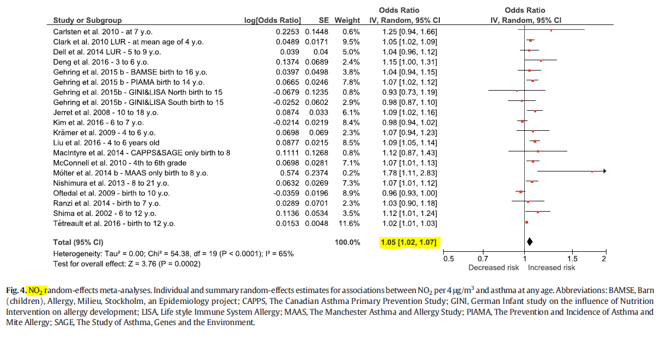
Methods – Concentration Response Functions
Notes:
OR 1.05 per 4 ug/m3

Slide 19
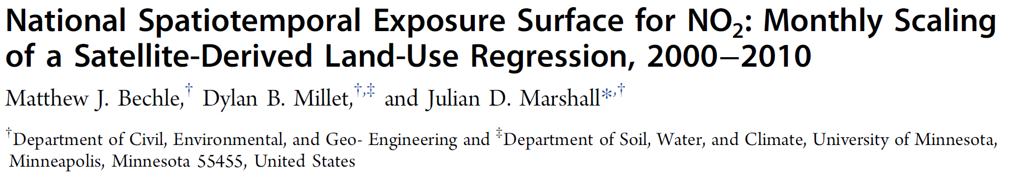
Methods – Exposure
Annual average concentration of NO₂ (ug/m³ )
Year 2010
Centroid of each census blocks

Slide 20
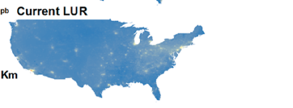
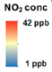
Methods – Exposure (NO₂)
Bechle et al. (2015) - Land Use Regression (LUR)
EPA air quality monitor readings
Satellite data
GIS (impervious surfaces, elevation, major roads, residential roads, and distance to coast)
Temporal scaling (average monthly, 2000-2011)
Highly predictive (R² = 0.82)
Notes:
(Bechle et al. 2015)

Slide 21

Methods - Software Used

Slide 22
Results

Slide 23
Results – Census Data
5+ million populated census blocks
70+ million children
(80%) live in Urban areas
Geographic characteristics | Total populated census blocks | 6,182,882
 | Total census-designated urban areas | 3,590,278 (58%)
Demographic characteristics | Total population | 306,675,006
 | Total population of children (birth – 18) | 73,690,271 (24%)
 | Mean (range) number of children in census blocks | 12 (0-2214)
Population of children by living location | Rural | 13,763,183 (19%)
 | Urban clusters (≥2,500 and <50,000 people) | 6,994,464 (9%)
 | Urbanized area (≥50,000 people) | 52,932,624 (72%)
Population of children by median household income | <$20,000 | 2,614,804 (4%)
 | $20,000 to <$35,000 | 12,770,843 (17%)
 | $35,000 to <$50,000 | 18,573,954 (25%)
 | $50,000 to <$75,000 | 21,953,876 (30%)
 | ≥$75,000 | 17,763,239 (24%)
Notes:
Included census blocks :
5+ Blocks
72+ million children each year
~80% live in urban areas

Slide 24
Results – Asthma incidence and prevalence
 | 2006 | 2007 | 2008 | 2009 | 2010 | Total
BRFSS sample (weighted) | 55,094 (50,674,742) | 59,487 (43,661,381) | 61,862 (53,327,550) | 59,821 (47,747,373) | 57,200 (39,975,264) | 293,464
Ever asthma sample (weighted) | 7,168 (6,493,224) | 7,971 (5,763,409) | 8,255 (7,218,400) | 8,126 (6,279,938) | 7,483 (5,158,455) | 39,003
ACBS Sample (weighted) | 2,017 (4,580,870) | 2,797 (5,459,638) | 3,924 (4,343,245) | 4,095 (4,154,076) | 2,196 (3,116,669) | 16,156
Incident case sample (weighted) | 154 (404,276) | 173 (312,917) | 169 (385,818) | 153 (297,546) | 160 (319,743) | 809
At-risk sample (weighted) | 48,080 (30,825,589) | 51,689 (36,050,557) | 53,776 (26,491,259) | 51,848 (25,942,087) | 49,877 (22,900,850) | 255,270
Incidence rate | 13.1 | 8.7 | 14.6 | 11.5 | 14.0 | 11.6*
Prevalence rate | 12.8 | 13.2 | 13.5 | 13.2 | 12.9 | 13.1**
Number of states included | 18 | 26 | 20 | 17 | 17 | 32***

Slide 25
State | 2006* | 2007* | 2008* | 2009* | 2010* | Aggregate IR | Aggregate PR
Alabama |  |  |  |  |  | 11.6 | 14.4
Arizona | 23.7 | 6.8 |  |  |  | 15.2 | 13.1
Arkansas |  |  |  |  |  | 11.6 | 13.1
California | 12.1 | 6.5 |  |  |  | 9.3 | 12.2
Colorado |  |  |  |  |  | 11.6 | 13.1
Connecticut |  | 9.9 | 14.1 | 10.8 | 13.5 | 12 | 16
Delaware |  |  |  |  |  | 11.6 | 18.2
District of Columbia | 5.3 | 28.8 |  |  |  | 17.7 | 19.9
Florida |  |  |  |  |  | 11.6 | 13.1
Georgia | 6.4 | 5.8 | 9.1 | 16.6 | 6.9 | 9.1 | 15.1
Idaho |  |  |  |  |  | 11.6 | 9
Illinois |  | 4.2 |  | 9.2 |  | 6.7 | 12.4
Indiana | 25.4 | 9.3 | 13.4 | 9.9 | 17.6 | 15.2 | 12.8
Iowa | 5 | 4 | 9.9 |  |  | 6.3 | 8.4
Kansas | 7.8 | 9.9 | 9.9 | 8.3 | 9 | 9 | 11.6
Kentucky |  |  |  |  |  | 11.6 | 14
Louisiana |  |  |  | 5.8 |  | 5.8 | 13
Maine | 13 | 8.7 | 5.8 |  |  | 9.2 | 13.2
Maryland | 16.2 | 8.6 | 11 | 17.3 | 2.3 | 11.2 | 14.8
Massachusetts |  |  |  |  |  | 11.6 | 13.1
Michigan | 5.3 | 7.7 | 5.2 | 13.4 | 29.3 | 12 | 13.6
Minnesota |  |  |  |  |  | 11.6 | 9.5
Mississippi |  | 10.8 |  |  | 17.2 | 14 | 14.2
Missouri | 21.2 | 10.3 | 7.2 |  |  | 12.9 | 13.9
Montana | 2.8 | 2 |  | 3.7 | 8.5 | 4.3 | 9.7
Nebraska | 11.9 | 8.3 | 8.9 | 3.3 | 12.9 | 9.1 | 9.3
Nevada |  |  |  |  |  | 11.6 | 10.9
New Hampshire | 11.5 | 13.8 | 10.4 |  |  | 12 | 12.1
New Jersey |  |  | 6.3 | 12.5 | 10.5 | 9.8 | 14.3
New Mexico |  | 3.2 | 9.5 |  | 7.2 | 6.7 | 12
New York | 12.9 | 6.1 | 28.4 | 11.2 |  | 14.7 | 15.8
North Carolina |  |  |  |  |  | 11.6 | 13.1
North Dakota |  |  |  |  |  | 11.6 | 8.9
Ohio |  | 13.1 | 17 |  |  | 15.1 | 12.3
Oklahoma |  | 9.2 | 10.1 |  | 12.9 | 10.8 | 14
Oregon |  | 11.1 |  |  |  | 11.1 | 11.1
Pennsylvania |  | 21.8 |  |  | 4.3 | 13.2 | 13.9
Rhode Island |  |  | 15.3 | 13.2 |  | 14.3 | 16.1
South Carolina |  |  |  |  |  | 11.6 | 13.1
South Dakota |  |  |  |  |  | 11.6 | 13.1
Tennessee |  |  |  |  |  | 11.6 | 13.1
Texas | 14.4 |  | 18.2 | 12.5 | 21 | 16.6 | 13.1
Utah |  | 15.4 | 11.9 | 5.6 | 9.3 | 10.4 | 10.2
Vermont | 13.5 | 4.4 | 8.5 | 21.2 | 10.4 | 11.5 | 13.8
Virginia |  |  |  |  |  | 11.6 | 13.6
Washington |  |  |  | 7.9 | 5.6 | 6.8 | 10.8
West Virginia |  | 11.8 |  |  |  | 11.8 | 12.7
Wisconsin | 12.3 |  |  |  |  | 12.3 | 10.6
Wyoming |  |  |  |  |  | 11.6 | 9.5

Slide 26
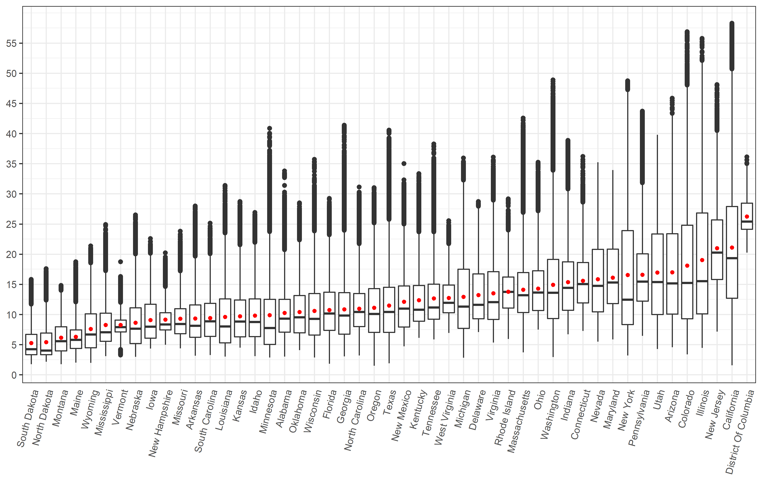
Results - NO₂ concentration
 |  | Mean | Min | Max
Total |  | 13.2 | 1.5 | 58.3
By living location | Rural | 8.0 | 1.5 | 37.7
 | Urban cluster | 12.0 | 1.6 | 35.6
 | Urbanized area | 18.4 | 2.6 | 58.3
By median household income | <$20,000 | 16.1 | 2.0 | 56.8
 | $20,000 to <$35,000 | 13.2 | 1.6 | 58.3
 | $35,000 to <$50,000 | 11.8 | 1.5 | 58.0
 | $50,000 to <$75,000 | 12.8 | 1.6 | 55.7
 | ≥$75,000 | 16.5 | 2.1 | 55.5
NO₂ concentration:
13.2(1.5-58.3) ug/m³
Notes:
Overview of the mean values only
Thoroughly explain how to read the boxplot (go through it slowly and ask if this is clear)
The box plot has three pollutants (blue for NO2, yellow for PM10, and red for PM2.5) {point to bars when explaining}
For each pollutant we have two years (left bar is year 2000 and right bar is year 2010) {point to bars when explaining}
The X axis is the pollutant
The Y axis is the concentration of the pollutant (each point represents a census block)

Slide 27
Results – Burden
 | Results using flat national-level IR |  |  | Results using state-specific IR |  |  | Difference (%)
 | Incident cases | AC | AF | Incident cases | AC | AF | Incident cases | AC | AF
Total | 794,934 | 141,931 | 17.9% | 747,437 | 131,739 | 17.6% | -6.0% | -7.2% | -1.7%
Rural | 148,470 (19%) | 14,466 (10%) | 9.7% | 140,799 (19%) | 13,788 (10%) | 9.8% | -5.2% | -4.7% | 1.0%
Urban cluster | 75,453 (9%) | 9,844 (7%) | 13.0% | 70,524 (9%) | 9,206 (7%) | 13.1% | -6.5% | -6.5% | 0.8%
Urbanized area | 571,011 (72%) | 117,621 (83%) | 20.6% | 536,113 (72%) | 108,745 (83%) | 20.3% | -6.1% | -7.5% | -1.5%
<$20,000 | 28,207 (4%) | 5,892 (4%) | 20.9% | 27,770 (4%) | 5,786 (4%) | 20.8% | -1.5% | -1.8% | -0.5%
$20,000 to <$35,000 | 137,765 (17%) | 25,794 (18%) | 18.7% | 132,843 (18%) | 24,699 (19%) | 18.6% | -3.6% | -4.2% | -0.5%
$35,000 to <$50,000 | 200,367 (25%) | 34,549 (24%) | 17.2% | 188,466 (25%) | 32,088 (24%) | 17.0% | -5.9% | -7.1% | -1.2%
$50,000 to <$75,000 | 236,827 (30%) | 40,540 (29%) | 17.1% | 221,334 (30%) | 37,253 (28%) | 16.8% | -6.5% | -8.1% | -1.8%
≥$75,000 | 191,621 (24%) | 35,128 (25%) | 18.3% | 176,880 (24%) | 31,885 (24%) | 18.0% | -7.7% | -9.2% | -1.6%

Slide 28
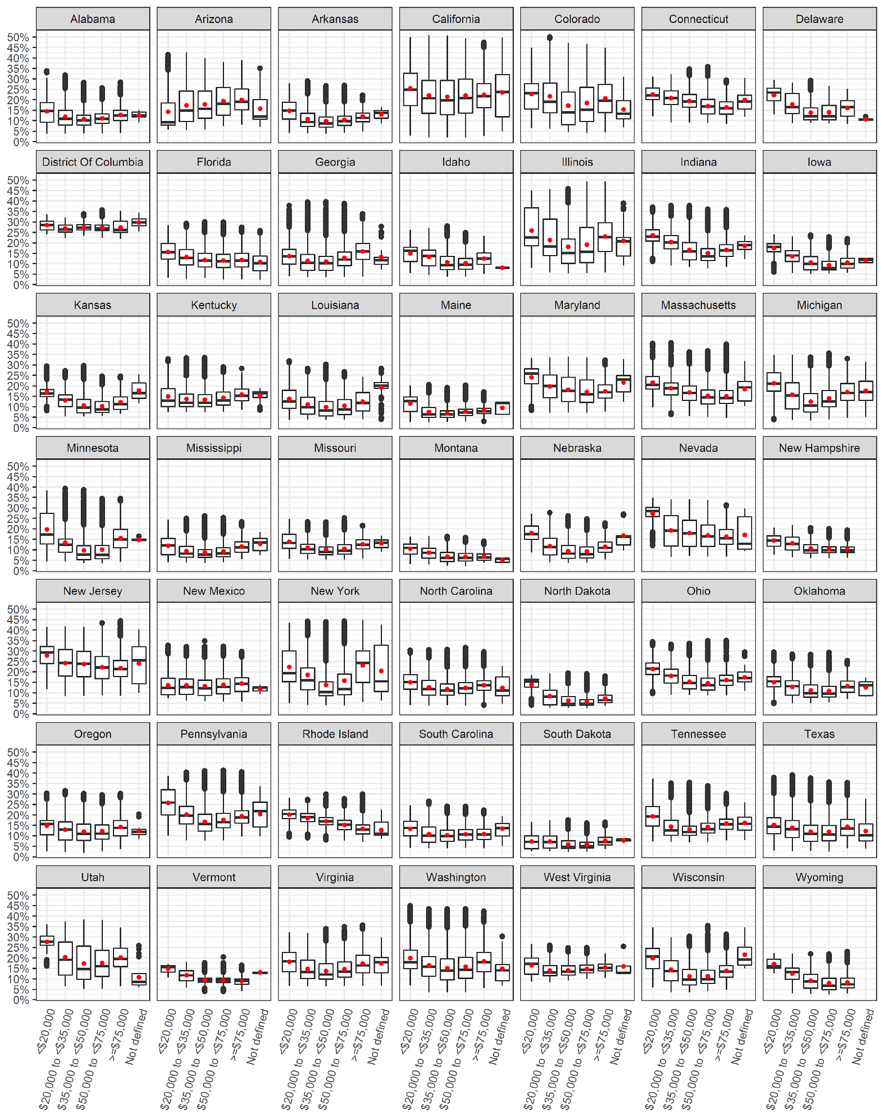
Attributable fraction distribution by median household income for each state

Slide 29
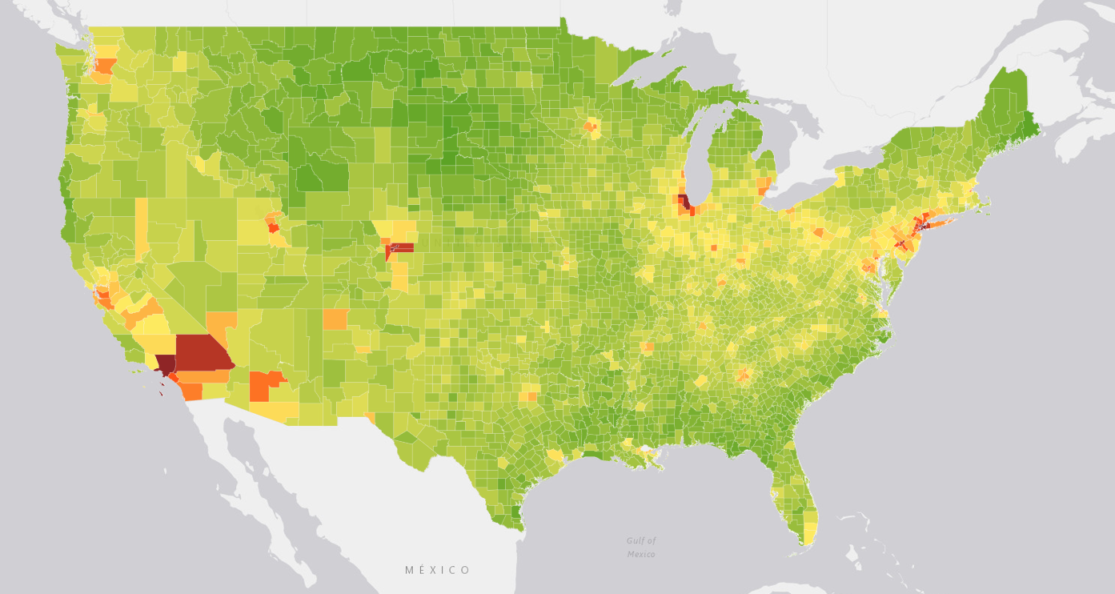
Interactive maps of results at the county level

Slide 30
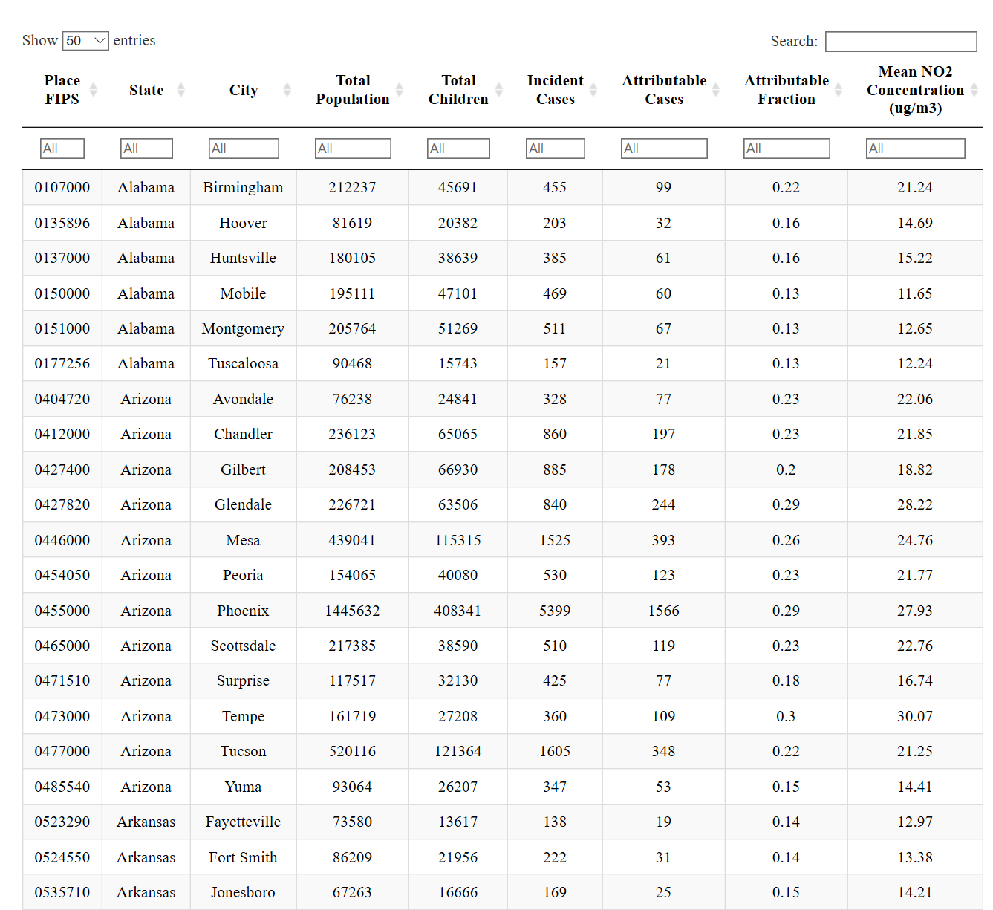
Interactive table of results at the city level

Slide 31
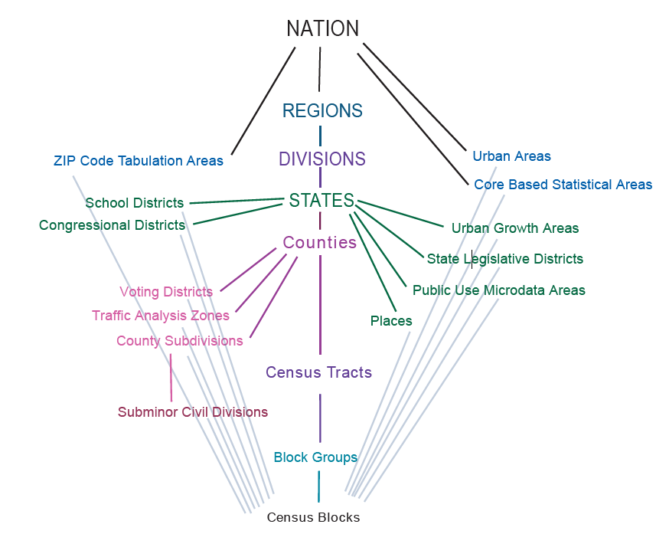
Data sets at multiple geographical levels summarizing the burden estimates
County
City (Place)
Zip code
School District

Slide 32
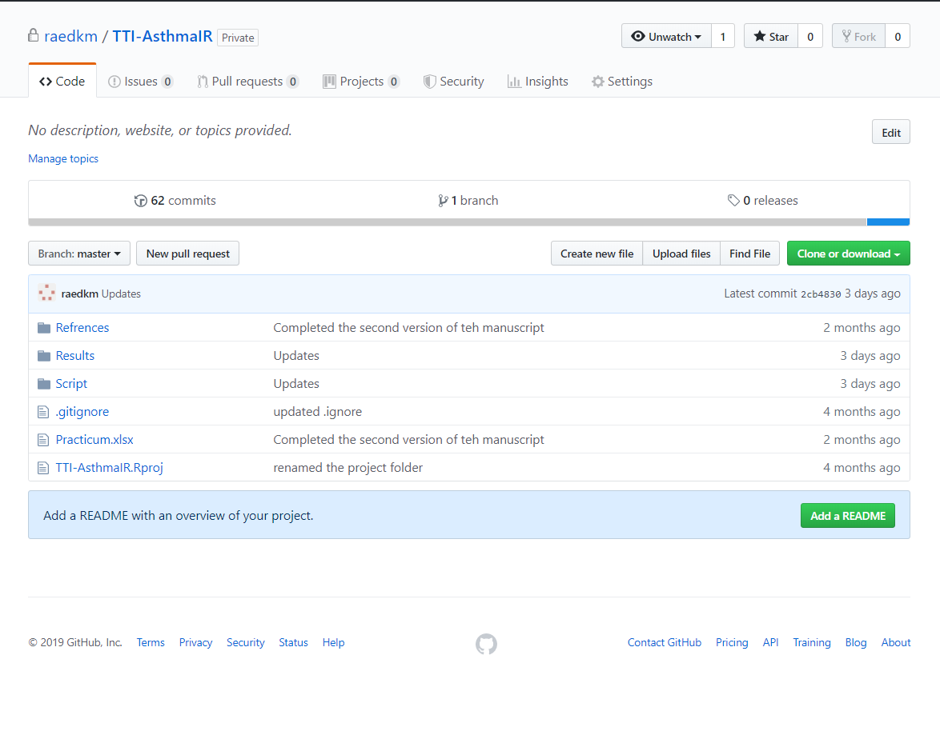
GITHUB repository

Slide 33
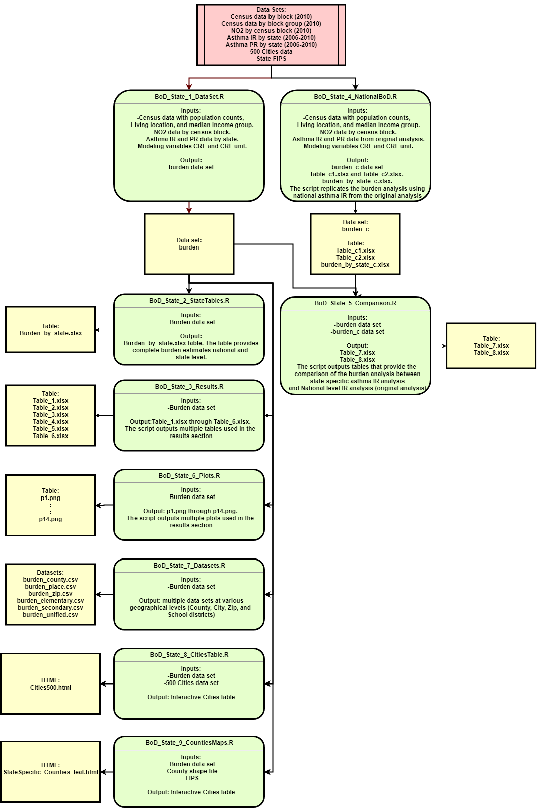
Step by step analysis guide for running the code

Slide 34
Thank you

Slide 35
Outline (Slide is hidden)
Introduction
Childhood asthma (definition, statistics, costs associated, and causes)
New emerging evidence of TRAP
Rational for the study (Meta-analysis, development of LUR model)
What this study tries to achieve (estimate US burden across two years)
Methods and {some results}
Study area and time points
Census data
Asthma incidence and prevalence {results}
Concentration response function {results}
LUR Models
Formulas
“Safety level” scenarios
Sensitivity analysis
Software used
Results
Pollutants concentration results by state
Attributable number of asthma incident cases
Attributable number of asthma incident cases by living location
Attributable number of asthma incident cases by median household income
“Safe levels” scenarios
Sensitivity analysis
Interactive Maps
Discussion
Summary of key findings
Comparing with previous studies
Strengths and limitations
Conclusion
References

